Slide 1
JAVA GUI BASICS
Hello Window
Jbutton
Event handling
Layout manager, and other component
Multiple event listener

Slide 2
Getting Started
A GUI (graphical user interface) is a system of interactive visual components for computer software. A GUI displays objects that convey information, and represent actions that can be taken by the user. The objects change color, size, or visibility when the user interacts with them.
Java AWT - an API to develop Graphical User Interface (GUI) or windows-based applications in Java.
Java Swing - is a part of Java Foundation Classes (JFC) that is used to create window-based applications. It is built on the top of AWT (Abstract Windowing Toolkit) API and entirely written in java.

Slide 3
Hello Window
//GUI.java
import javax.swing.JFrame;
public class GUI {
private JFrame frame;
private int width;
private int height;
//constructor to initialize the JFrame
public GUI(int w, int h) {
frame = new JFrame();
width = w;
height = h;
}
//public method to setup the GUI
public void setUpGUI() {
frame.setSize(width,height);//setting window size
frame.setTitle("Hello GUI");//setting window name
frame.setDefaultCloseOperation(JFrame.EXIT_ON_CLOSE);
frame.setVisible(true);//to make the window visible
}
}
//Main.java
public class Main {
public static void main(String[] args) {
GUI gui = new GUI(640,480);
gui.setUpGUI();
}
}

Slide 4
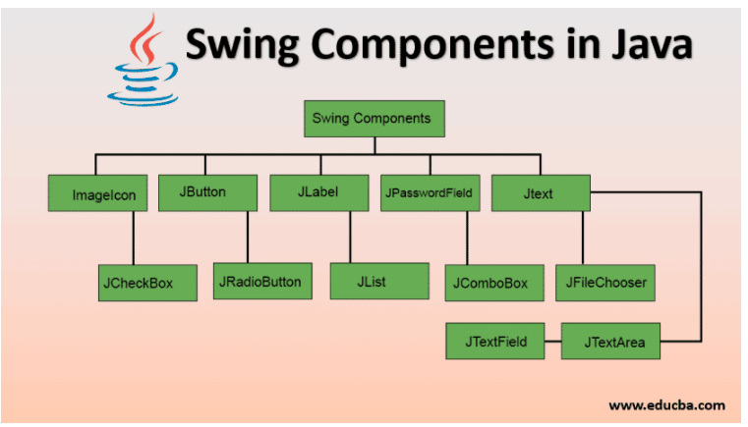

Slide 5
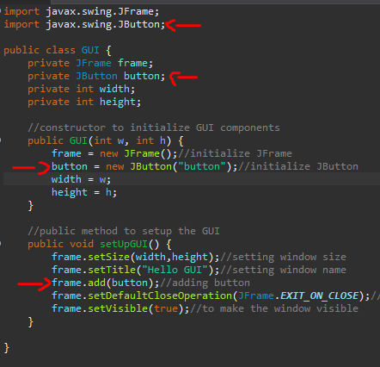
Adding JButton

Slide 6
Java Event Handler
Consist of different objects that interact with each other
Will allow use to tell our program to respond in some way whenever some specific event happens
Event Handler is made up of 4 general things:
Event
Event Source
Event Listener
Response

Slide 7
Event
Something that happens while the program is running
Examples:
When the user presses a keyboard key
When a window closes
When an image file finishes loading

Slide 8
Event Source
The object that dispatches the event
Example:
Button
TextField

Slide 9
Event Listener
Objects that are notified when an event is dispatched
Waits for an event to happen

Slide 10
Response
What will happen when an event occurs
Examples:
Click button -> play a sound
Click button -> display an image
The response is specified using the event listener object

Slide 11

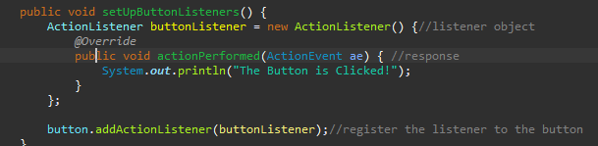
How to implement
Import event libraries
Create a Object listener and Response

Slide 12
Layout Managers
Use to set how components within a container are positioned and sized
Example:
BorderLayout
GridLayout
FlowLayout
Some layout managers are part of AWT, some are part of swing

Slide 13
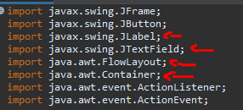
How to Implement
Importing more libraries
Importing FlowLayout and Container
Importing more swing components
Jlabel is for text
JTextField is for input field

Slide 14
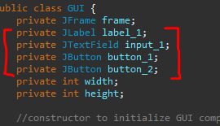
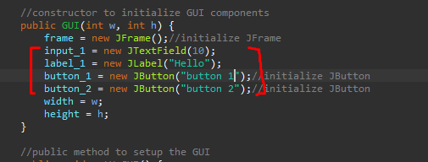
adding more components Initializing them

Slide 15
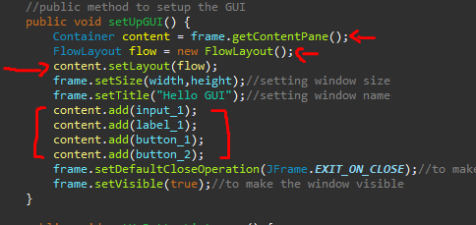
Creating a container object for our JFrame so we can apply it to FlowLayout Object
Last time we added our components to the JFrame, now reflace it with the container object

Slide 16
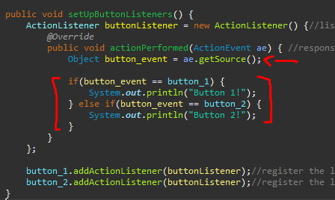
Implementing a single action listener to multiple buttons
Create an object to catch ActionEvent then create an conditional statement for the different components.

Slide 17
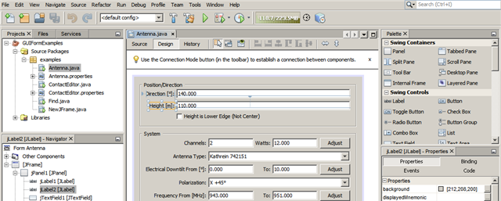
Alternative for manual coding
You can use NetBeans IDE: GUI Builder
Tutorials : https://www.youtube.com/playlist?list=PLNHw_0qv1zy-cVdEX6HqJX2a8ZLHbG3Ox

Slide 18
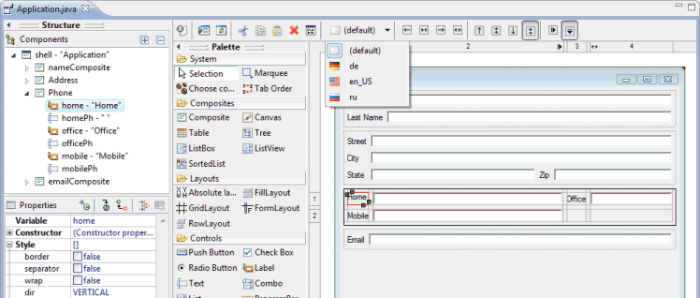
Eclipse Window Builder
Tutorials: https://www.youtube.com/playlist?list=PLnKkIQKFwJQsoUAOEjBtovxi61gkvBr77

Slide 19
More Learning Links
JAVA GUI - https://www.youtube.com/watch?v=Kmgo00avvEw
JAVA AWT:
https://www.javatpoint.com/java-awt
https://www.tutorialspoint.com/awt/index.htm
JAVA SWING:
https://www.javatpoint.com/java-swing
https://docs.oracle.com/javase/tutorial/uiswing/

